Slide 1
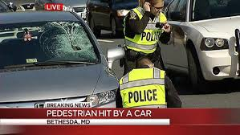
Comprehensive Pedestrian Enforcement
Captain Thomas C. Didone
Montgomery County, MD Police Department

Slide 2
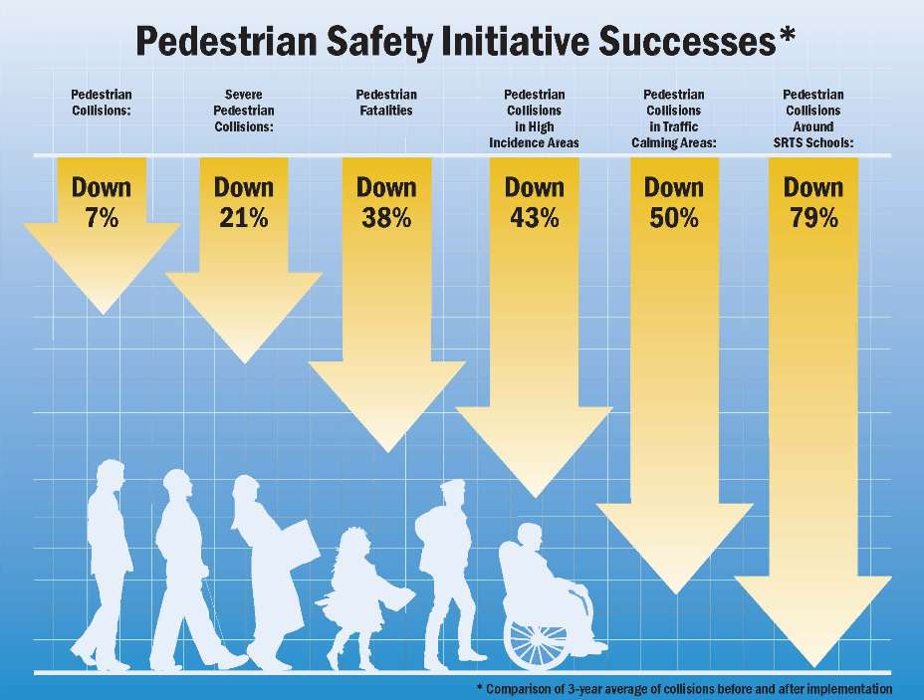
Pedestrian Safety Initiative – Results

Slide 3
Comprehensive Pedestrian Enforcement
Problem Identification
Engineering Concerns
Education Programs
Enforcement Operations

Slide 4
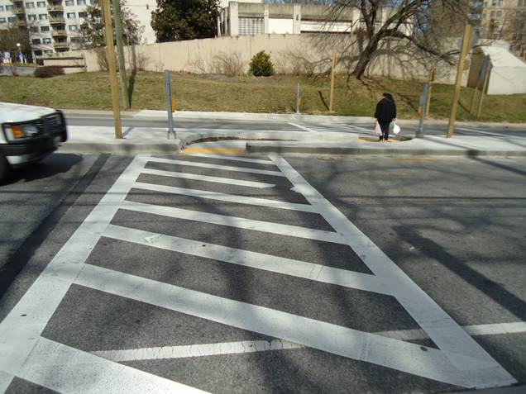
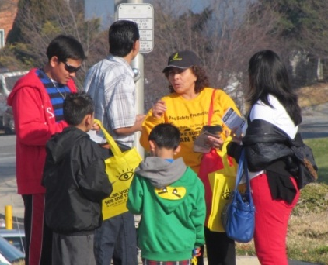
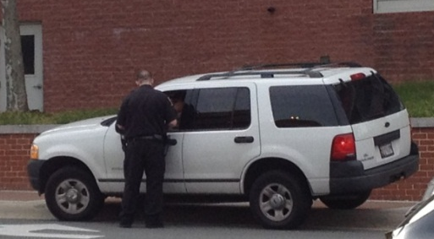
Three Pronged Approach
Close Coordination of Engineering, Education, and Enforcement
Engineering
Education
Enforcement
Changing Pedestrian and Driver Behavior

Slide 5

Do You Have a Problem?

Slide 6
Comprehensive Pedestrian Enforcement
Identifying the problem
  Data Driven
  Statistics
Who, How & When
Where do they occur?
-High Incidence Areas, Hot Spots
Causation factors

Slide 7
Montgomery County Pedestrian Collisions and Fatalities
With four years of data since the launch of the Pedestrian Safety Initiative in July 2009, DOT and MCPD looked at the change in the average number of collisions pre- and post-launch.
 | 2005 | 2006 | 2007 | 2008 | 2009 | 2010 | 2011 | 2012 | 2013 | Pre-Initiative Average (2005-2009) | Post-Initiative Average (2010-2013) | Change
January | 36 | 31 | 32 | 48 | 34 | 34 | 28 | 40 | 50 | 36 | 38 | +6%
February | 28 | 28 | 33 | 30 | 37 | 39 | 27 | 36 | 38 | 31 | 35 | +13%
March | 37 | 28 | 34 | 37 | 31 | 33 | 38 | 27 | 36 | 33 | 34 | +3%
April | 26 | 25 | 35 | 34 | 28 | 33 | 36 | 27 | 43 | 30 | 35 | +17%
May | 27 | 36 | 34 | 47 | 46 | 33 | 28 | 36 | 40 | 38 | 35 | -8%
June | 41 | 33 | 29 | 24 | 41 | 33 | 17 | 35 | 35 | 34 | 30 | -12%
July | 24 | 29 | 20 | 37 | 36 | 33 | 24 | 23 | 30 | 29 | 28 | -3%
August | 28 | 37 | 26 | 36 | 32 | 26 | 33 | 31 | 36 | 32 | 32 | 0%
September | 39 | 39 | 38 | 35 | 30 | 41 | 32 | 35 | 41 | 36 | 37 | +3%
October | 48 | 42 | 37 | 31 | 41 | 44 | 43 | 44 | 56 | 40 | 47 | +10%
November | 48 | 49 | 60 | 38 | 46 | 43 | 42 | 48 | 40 | 48 | 43 | -18%
December | 52 | 52 | 34 | 47 | 52 | 44 | 51 | 41 | 38 | 47 | 44 | -6%
Total Collisions | 434 | 429 | 412 | 444 | 454 | 436 | 399 | 423 | 483 | 435 | 435 | 0%
Per 100,000 | 46.7 | 45.9 | 43.8 | 46.6 | 46.8 | 44.9 | 40.5 | 42.8 | 47.5 | 46.0 | 43.9 | -5%
Level 4 & 5 Collisions (% of total) | 130 (30%) | 142 (33%) | 119 (29%) | 115 (26%) | 132 (29%) | 113 (26%) | 104 (26%) | 82 (19%) | 85 (18%) | 128 | 96 | -25%
Per 100,000 | 14.0 | 15.2 | 12.7 | 12.1 | 13.6 | 11.6 | 10.6 | 8.6 | 8.4 | 13.5 | 9.8 | -27%
Total Fatalities* | 10 | 18 | 17 | 19 | 14 | 13 | 11 | 6 | 13 | 16 | 11 | -31%
Per 100,000 | 1.1 | 1.9 | 1.8 | 2 | 1.4 | 1.3 | 1.1 | 0.6 | 1.3 | 1.6 | 1.1 | -31%
*Does not include bicycle fatalities
Source: MCPD. Data reporting prior to 2008 may not have been consistent with present practices.

Slide 8
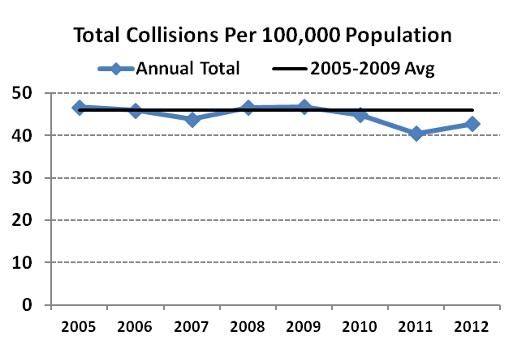
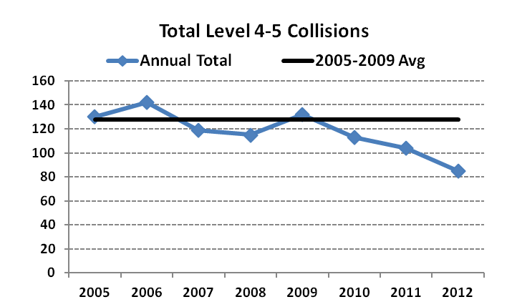
Pedestrian Collision Annual Trends
% Change | -2% | -5% | +6% | 0% | -4% | -10% | +6%
% Change | +9% | -16% | -3% | +14% | -14% | -8% | -18%
Total collisions per 100,000 population increased in 2012 , attributed to an increase in the number of collisions occurring in parking lots. The 2012 total remains below the pre-initiative average (2005 – 2009.)
The number of severe collisions (level 4-5) have dropped by 21% from the pre-initiative average (2005-2009.)

Slide 9
Collisions by Roadway Type
Highway Lane Miles
State | County | Toll | Municipal | Total
1,395.14 | 4,846.58 | 88.01 | 761.36 | 7,091.09
20% | 68% | 1% | 11% | 100%
In 2013, a plurality of collisions occurred on state maintained roadways which also represented the greatest increase in pedestrian collisions. Parking lot collisions rose sharply from 2010 to 2012 before dropping slightly in 2013. This may be an indication that the recently implemented parking lot initiative is working.
Source: MCPD

Slide 10
Pedestrian Collisions: Evening Commute
In 2012 and 2013, 27% of all collisions occurred between the hours of 5-8pm, up from 23% in 2011. The overall number of collisions in this time frame continues to rise.
Source: MCPD

Slide 11
Pedestrian Collision Variables: Fault
In 2013, the percentage of collisions where the driver was at fault continued to rise. Early education and enforcement efforts focused on pedestrians, but in 2013 these efforts began targeting drivers.
Source: MCPD

Slide 12
Pedestrian Collision Variables: Fault
N/A
There was a 5 percentage point increase in at fault pedestrians between the ages of 10 and 19 (school age children and young adults). Pedestrians at fault between the ages of 10 and 29 are over-represented compared to their share of the population as a whole. At fault drivers over age 80 appear to be slightly over-represented.
Source: MCPD; ACS 2012 5 Year Population Estimate; Maryland Highway Safety Office

Slide 13
High Incidence Areas (HIAs)/
High Crash Locations (HCLs)
(hot spots)
Areas with highest density of pedestrian crashes
High traffic volume
+ High pedestrian volume
HIA/HCL

Slide 14
High Incidence Areas: Four Corners
Background
Intersection of Colesville Rd and University Blvd
Safety audit conducted in January 2010
Montgomery Blair HS
Large student population
Many pedestrians cross mid-block
Lack of signal adherence by pedestrians
Numerous commercial access points
Heavy bus transit usage
Engineering, Education, and Enforcement
Pedestrian Signal Improvements
Completed MDSHA resurfacing project
Designated School Zone by MSHA
Upgraded signage and pavement markings
Montgomery Blair HS Education & Outreach Campaign (Fall 2011 - 2012)
Targeted Enforcement (2012 and 2013)

Slide 15

Engineering Concerns

Slide 16
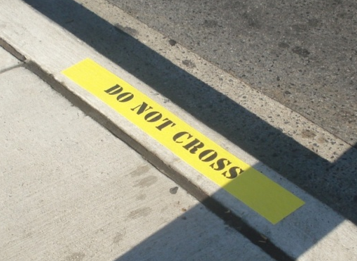
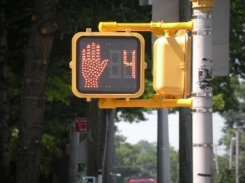
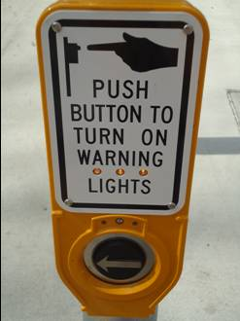
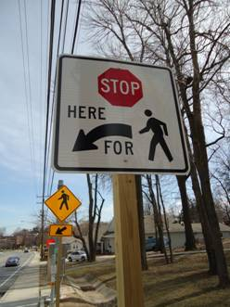
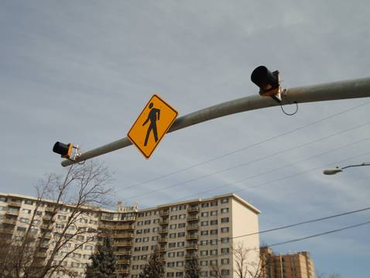
Engineering
Working with Local Department of Transportation
Infrastructure is critical for effective enforcement
Curb Markers
Countdown Pedestrian Indicators
Audible Push Button
Regulatory and Warning Signs
Flashing Beacons

Slide 17
Engineering
Conduct Audits
Perform Maintenance
Produce Enhancements
  Traffic Calming
  Infrastructure Improvements
  Automation
Funding

Slide 18

Education Programs

Slide 19
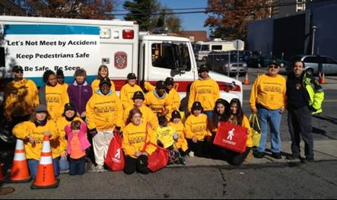
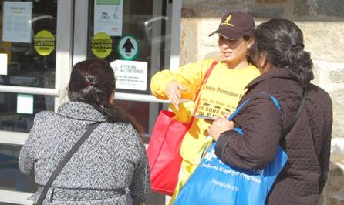
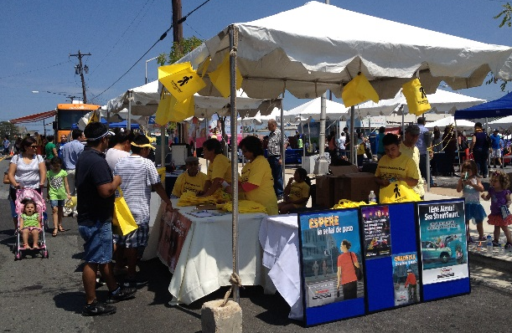
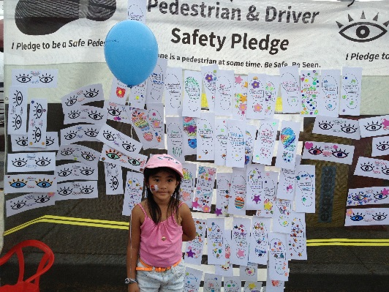
Community Education
Educate the public on pedestrian traffic laws
  If public does not know the law, hard for them to follow it
  Cooperative effort with Department of Transportation, Fire & Rescue, Citizen Groups

Slide 20
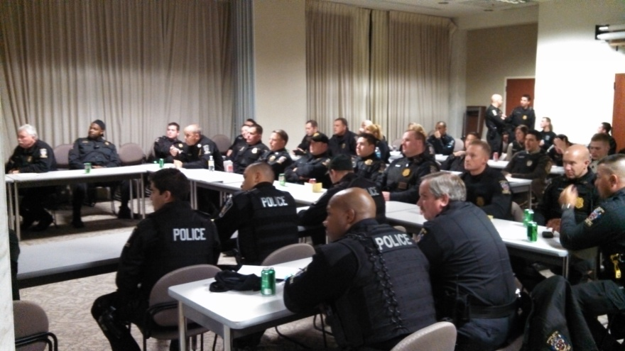
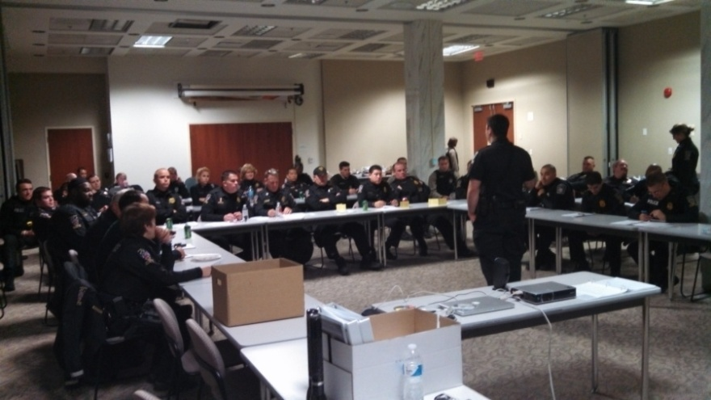
Officer Education
Educate officers on pedestrian traffic laws
  Officers more likely to enforce if they have knowledge
  Knowledge is power

Slide 21

Enforcement Operations

Slide 22
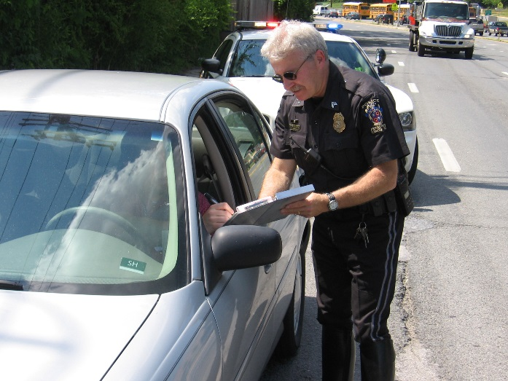
Enforcement
Team Approach
  Increase citizen contacts
  Officer safety
Highly motivated officers
Identify times and locations based on crash data
  High Incidence Areas
  Crosswalk stings
Both pedestrians and drivers are charged
Tickets not warnings

Slide 23
Three-Year Citation Total:
2,967

Slide 24
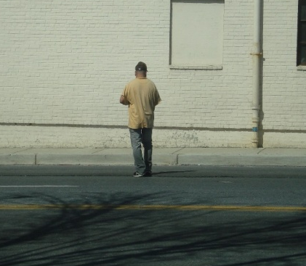
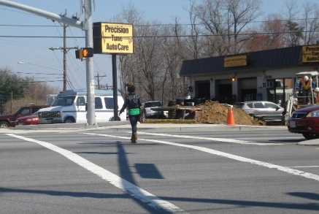
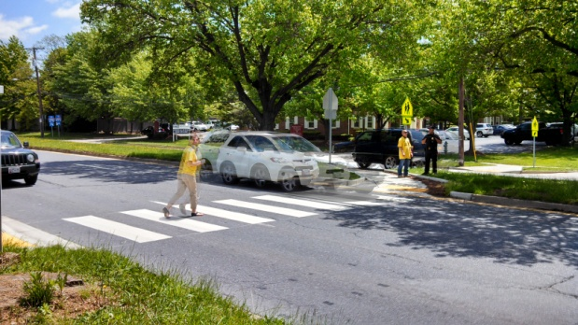
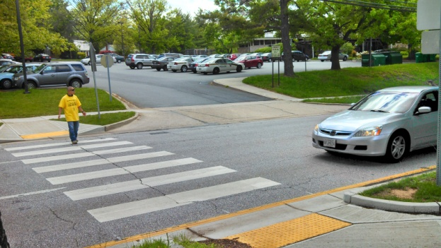
Enforcement (Continued)
Pedestrian Violations
  Midblock crossing
  Crossing against the signal
  Crossing unsafely
Driver Violations
  Failing to yield right of way in crosswalk
  Failing to yield on left and right turns
  Speed enforcement

Slide 25
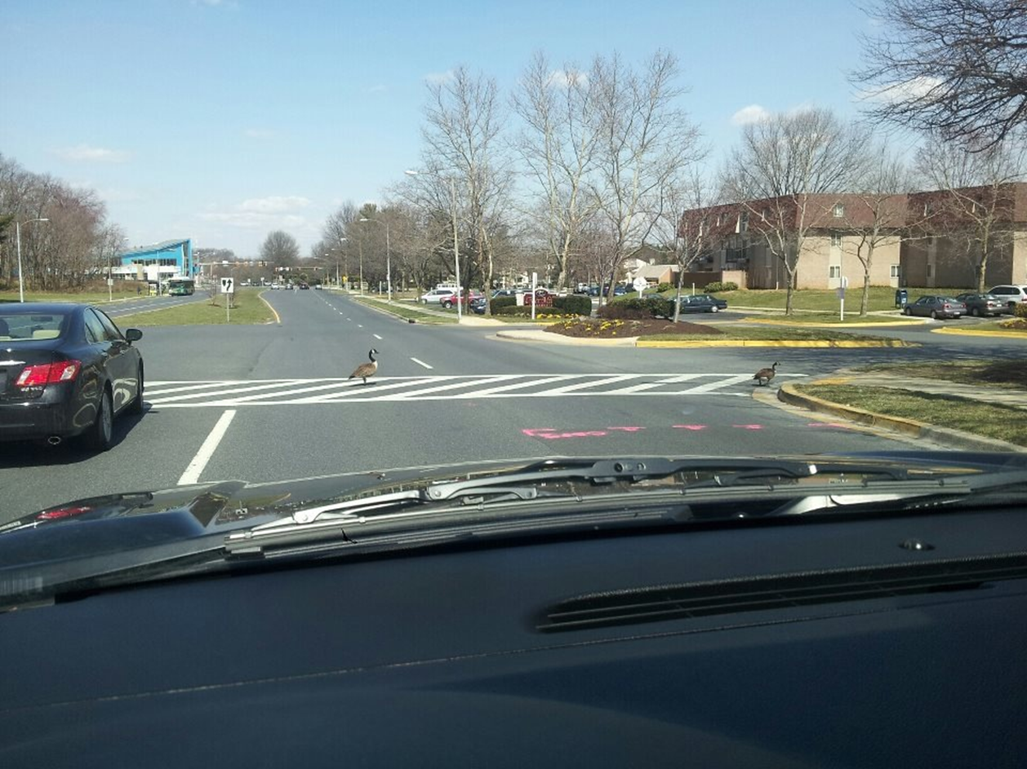
Crosswalk Sting

Slide 26
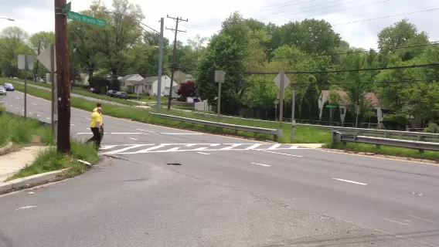
Crosswalk “Stings”
26

Slide 27
Final Phase….Courts
Come prepared with pictures and statistics
Articulate, Articulate, Articulate
Know the laws, Knowledge is Power!
Explain to the Court why this is being done
When this has been done in Montgomery County the District Court judges have been fully behind our enforcement efforts

Slide 28
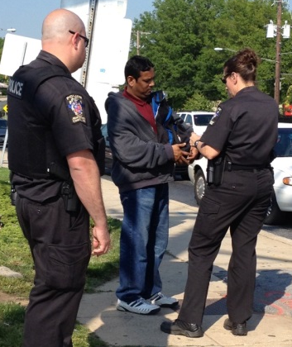
Summary
Need motivated officers
Team approach at locations
Warnings are less effective
Heavy enforcement changes behavior
Return trips keeps behavior in check

Slide 29
Questions
Captain Thomas C. Didone
Officer Jeremy Smalley
Montgomery County Police
240-773-6600
thomas.didone@montgomerycountymd.gov

